Slide 1
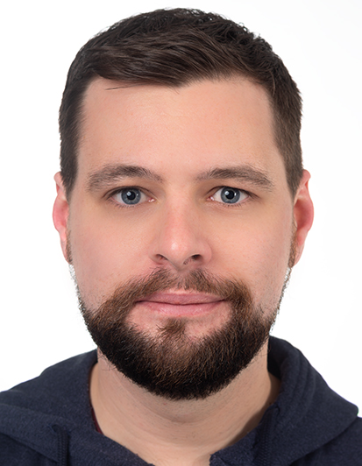
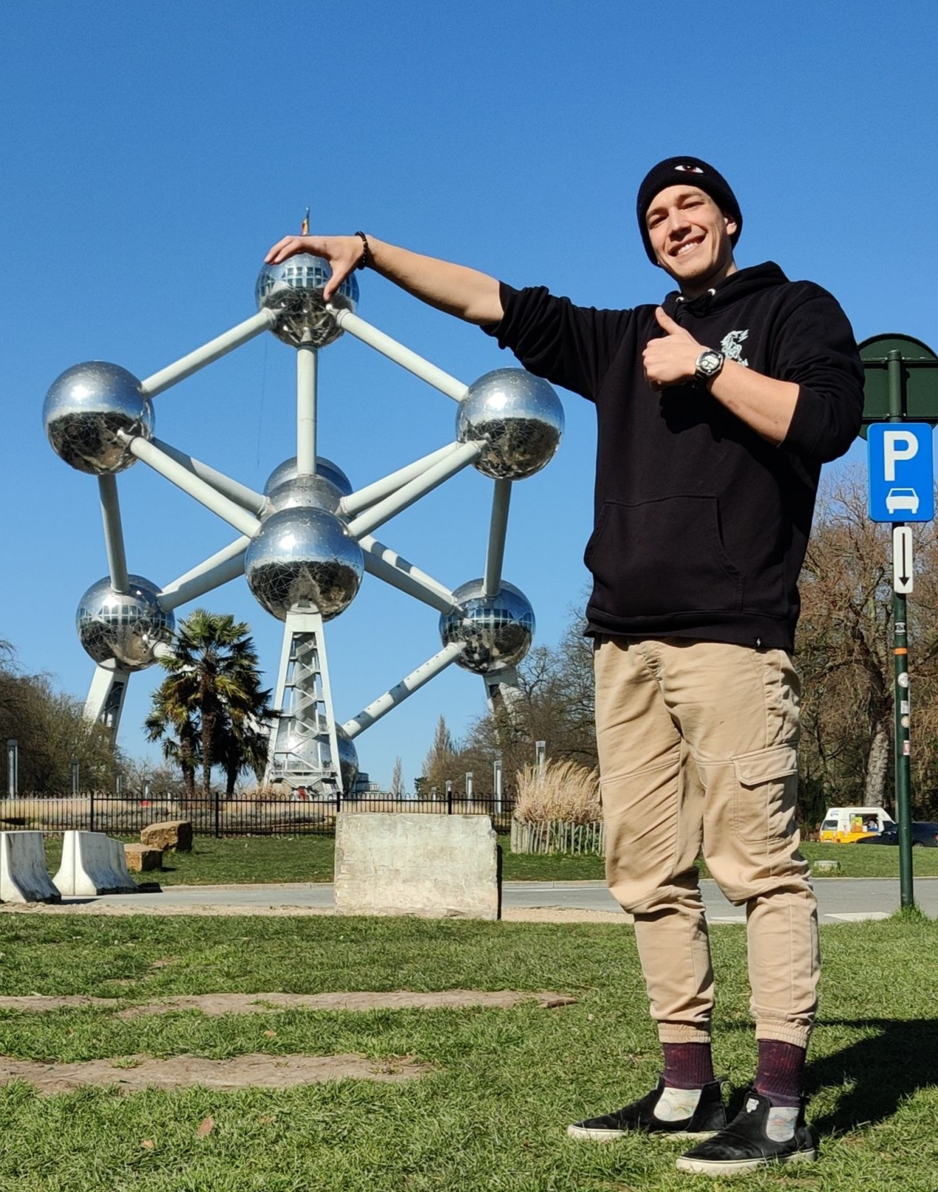
Physical Computing 2022 Group 1
Jakob Wietstock
Master 2nd Semester
Cedric Krug
Bachelor 5th Semester
Donatien Leray
Bachelor 5th Semester
<Foliennummer>

Slide 2
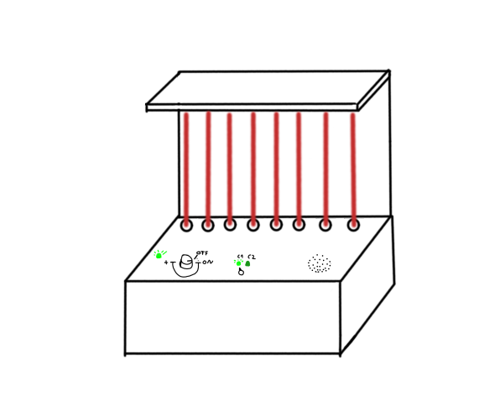
Topic: Laser Harp
Disruption of laserrays causes sound
Selection between two octaves
On/off dial
Volume selection
Build in speaker
<Foliennummer>

Slide 3
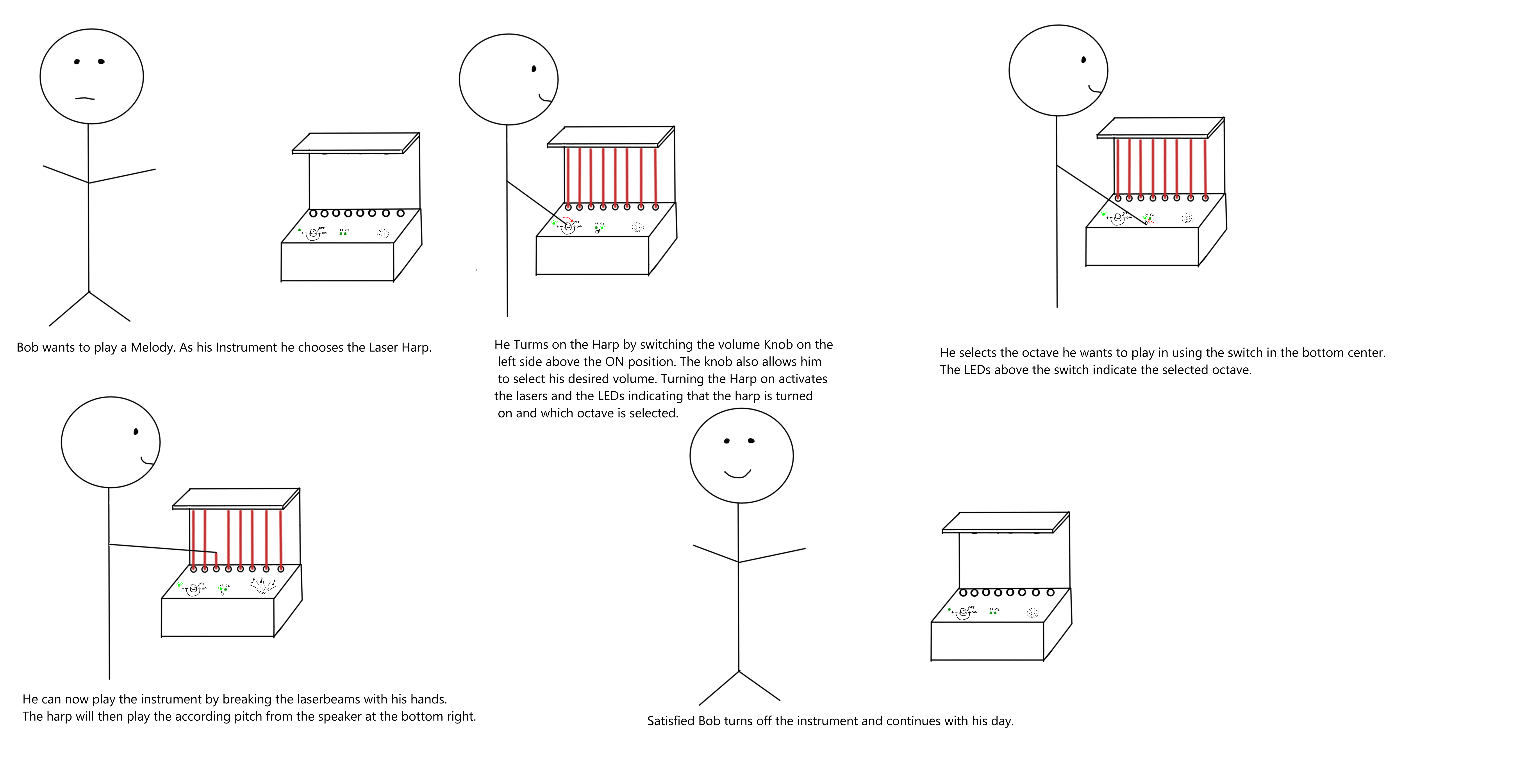
Storyboard
<Foliennummer>

Slide 4
Users
Casual users who want to play simple melodies
Children/People without much experience playing instruments
People who like eye-catching gimmicks/instruments
<Foliennummer>

Slide 5
Components
Frame (3d-printed or wooden)
8x Light dependent Resisstors
8x potentiometers
8x Laser Diodes
1x relay
Buttons and dials
Resistors
Maybe additional power supply for lasers
<Foliennummer>

